Slide 1
NEASQC industrial use cases

Slide 2
NEASQC factsheet
NExt ApplicationS of Quantum Computing
A 4-year project starting 1st September 2020
A multidisciplinary consortium of 12 companies and research labs
Funded by Horizon 2020 programme
  under the complementary call of the Quantum Technology Flagship
  4.67 M€
Boosting practical applications of quantum computing in the NISQ era

Slide 3
9 NISQ-compatible use cases
All use cases are endorsed by an industrial partner and investigated by an integrated team of industrial and academic partners
Chemistry
Drug discovery
Machine Learning & Optimisation
Reinforcement learning for stock management
Hard optimization problems for energy management
HPC mesh segmentation
Symbolic AI and graph algorithmics
Quantum natural language processing (QNLP)
Quantum probabilistic safety assessment (QPSA)
Quantum rule-based systems (QRBS) for breast cancer detection
CO₂ recapture
Financial applications

Slide 4


Sharing NEASQC’s research results
All of our scientific publications and public deliverables are in our Zenodo community: https://zenodo.org/communities/neasqc/
Our open source libraries are available from our GitHub: https://github.com/NEASQC/

Slide 5
Chemistry

Slide 6



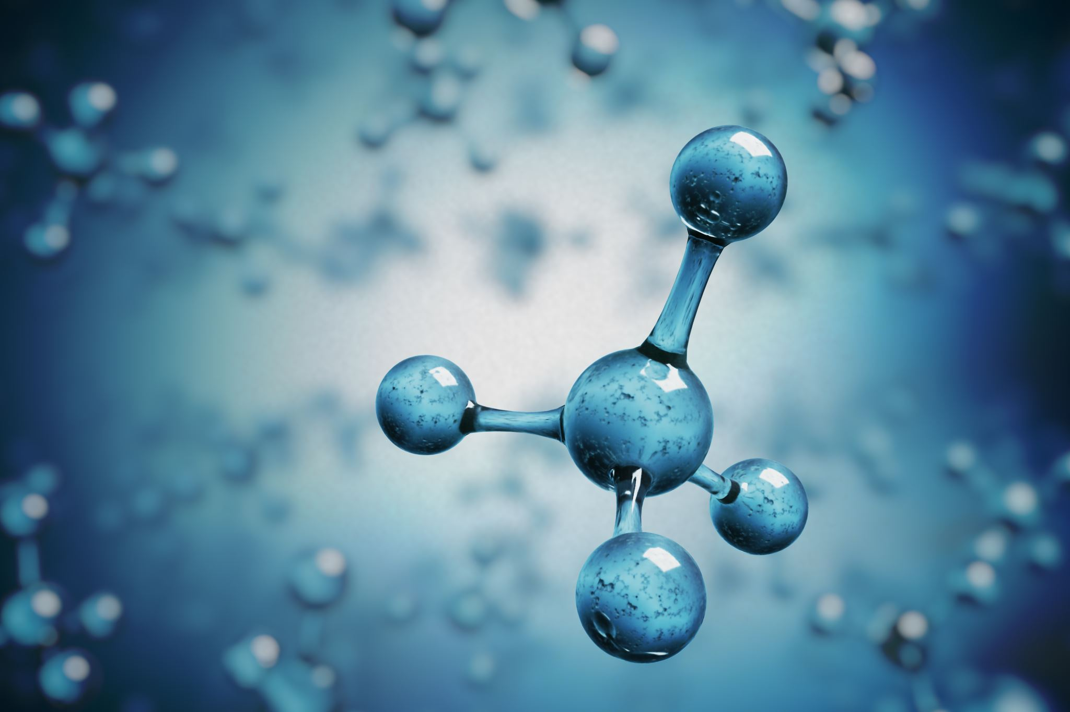
Drug discovery
Understanding chemical reactivity is very important for designing best way of making drug molecules. Quantum chemistry calculation accelerated by quantum computing will enable better informed decisions
Our repository collects Python scripts and Jupyter notebooks that allow the user to test different variational algorithms. It contains custom functions developed by NEASQC partners, such as Variational Hamiltonian Ansatz and PBO (Pre-Born-Oppenheimer) Hamiltonian.
  https://github.com/NEASQC/Variationals_algorithms
We also propose KraChem, a beta-version Python library designed for working with chemical molecules, fragmentation, based on chemical files input and mathematical tools from graph theory.
  https://github.com/NEASQC/qfrag
Publications: https://www.neasqc.eu/use-case/drug-discovery/

Slide 7


CO₂ recapture
CO₂ recapture helps reverse atmospheric flue-gas pollution. Quantum computing could help determine the most efficient adsorption surfaces for CO2
We released code that allows for the calculation of the ground state energy of benzene under spatial deformations by using a state-of-the-art QC methodology – the variational quantum eigensolver. Two types of QC ansatze are implemented. The code supports noisy simulations and three types of spatial deformations of the benzene molecule.
https://github.com/NEASQC/D4.2
Publications: https://www.neasqc.eu/use-case/co2-recapture/

Slide 8
Machine Learning & Optimisation

Slide 9

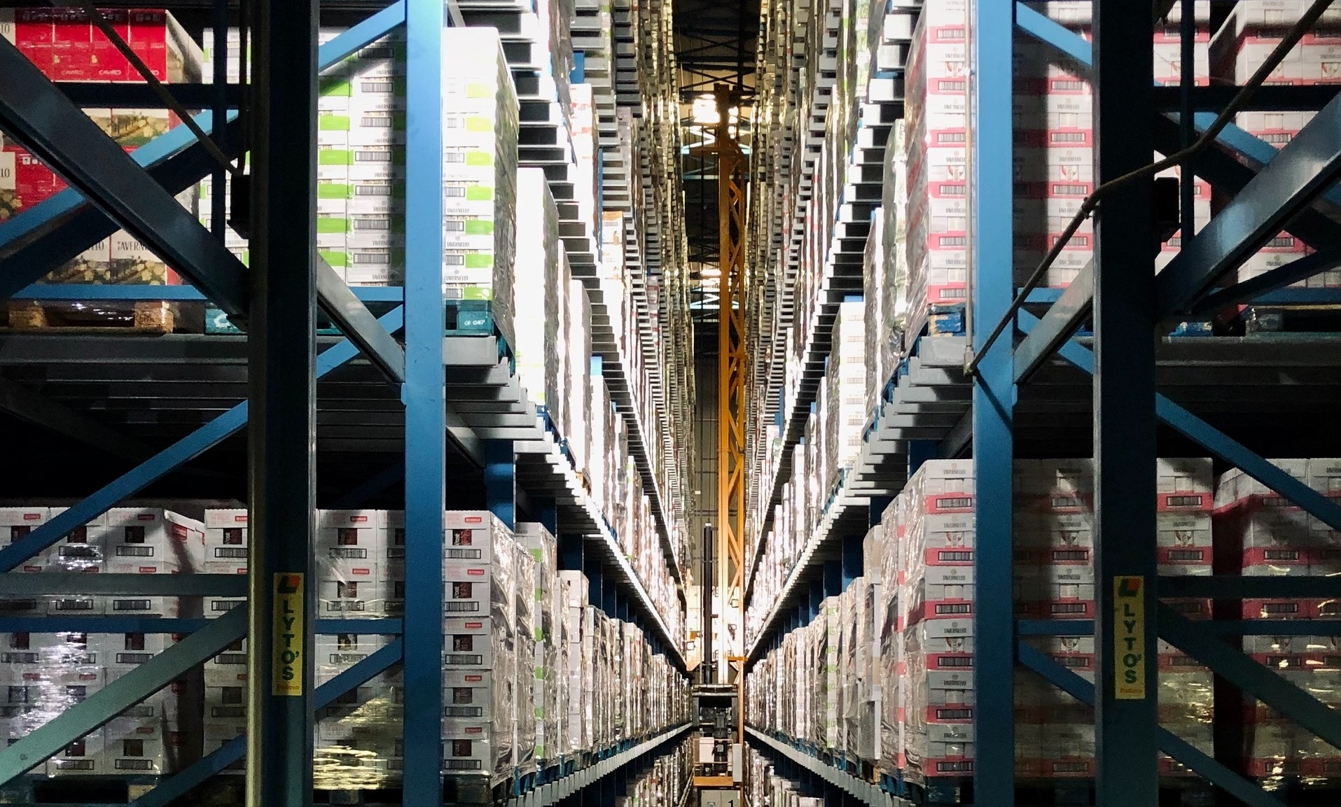
Reinforcement learning for stock management
In geoscience, inventory management and process optimization, optimal results depend on ideal sequences of decision. They require adaptive strategies, involving many correlated parameters. Quantum-enabled reinforcement learning could make it possible to tackle more complex correlations better and faster
Publications: https://www.neasqc.eu/use-case/reinforcement-learning-for-inventory-management/

Slide 10



Hard optimization problems for energy management
The rise of electric mobility requires “smart charging” solutions so as to optimise energy consumption and to contribute to the grid balance, while satisfying user needs. Some of the challenges of smart-charging could typically be solved faster and better by Quantum Computing
We are developing a hybrid quantum/ classical architecture for tackling large instances of these problems, as well as a ZX-Diagrams based approach to optimize QAOA circuits
Publications: https://www.neasqc.eu/use-case/hard-optimisation-problems-for-smart-charging-of-electric-vehicles/

Slide 11




Financial applications
Quantum Machine Learning and quantum Monte-Carlo methods could give financial companies an unparalleled competitive advantage in areas like portfolio optimisation, option pricing, or Value-at-Risk estimation
Our Quantum Quantitative Finance Library assembles different quantum algorithms and techniques for use in the financial industry
  https://github.com/NEASQC/FinancialApplications
Publications: https://www.neasqc.eu/use-case/financial-applications/

Slide 12

HPC mesh segmentation
Creating numerical meshes for realistic simulations (for example for seismic depth imaging and reservoir simulations) is a computationally challenging task. Quantum computing can be the main workhorse to increase the accuracy of their creation
Publications: https://www.neasqc.eu/use-case/hpc-mesh-segmentation/

Slide 13
Symbolic AI and graph algorithmics

Slide 14


Quantum natural language processing (QNLP)
Natural Language Processing supports applications such as machine translation or chatbots. However standard NLP methods may not take into account all the exploitable aspects of grammar. With Quantum Computing, new compute-intensive methods could be used to leverage certain properties of language
Our alpha SW prototypes explore a) the DisCoCat-based model using parameterised quantum circuits to encode a pre-defined dataset of sentences and b) Dressed Quantum Circuits in which pre-trained classical models are used as pre-processing layers in a transfer learning fashion
  https://github.com/NEASQC/WP6_QNLP/tree/v0.2-alpha-d0.9
Publications: https://www.neasqc.eu/use-case/quantum-natural-language-processing-qnlp/

Slide 15
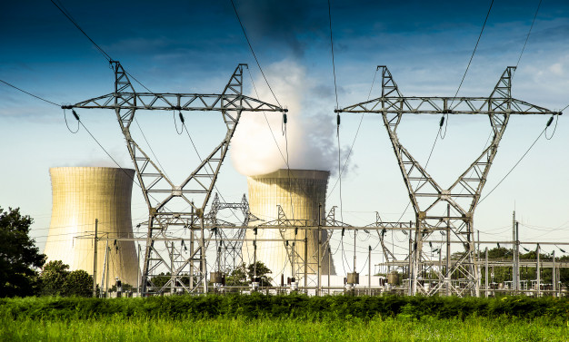
Quantum probabilistic safety assessment (QPSA)
Probabilistic Safety Assessment evaluates the safety of complex safety-critical systems, such as nuclear plants or railways. With novel Quantum Computing methods, this could turn into a real-time assessment, and support decision-making to enhance security.
Our open source code helps implement fault trees
  https://github.com/NEASQC/ft-2-quantum-sat
Publications: https://www.neasqc.eu/use-case/quantum-probabilistic-safety-assessment-qpsa/

Slide 16

Quantum rule-based systems (QRBS) for breast cancer detection
Medical reasoning is based on imprecise data and uncertain causal relationships, and the conclusions are obtained with a given probability. Since quantum computing is inherently probabilistic, the implementation of a quantum approach could improve current results
We are working on Quantum rule-based systems for the diagnosis and treatment of Breast Invasive Ductal Carcinoma
Main efforts have been done in a) implementation of inferential networks in a quantum environment, and b) definition of a quantum model for dealing with inaccurate knowledge
QRBS software library: https://github.com/NEASQC/qrbs/
Publications: https://www.neasqc.eu/use-case/algorithms-for-the-diagnosis-of-invasive-ductal-carcinoma/

Slide 17



Thank you for your attention! neasqc.eu
@neasqc company/neasqc-project

